Slide 1
Capability Driven Development
Janis Stirna
Stockholm University
js@dsv.su.se

Slide 2
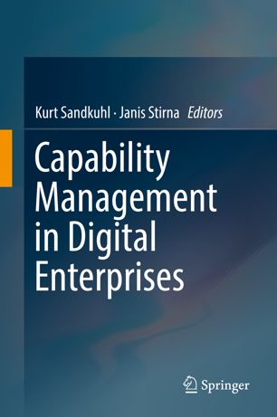

Outline
The general need for capability
Outline to Capability Driven Development (CDD)
CDD Methodology
CDD Environment
Capability in other frameworks
Based on EU FP7 project CaaS – Capability as a Service in digital enterprises
http://caas-project.eu

Slide 3
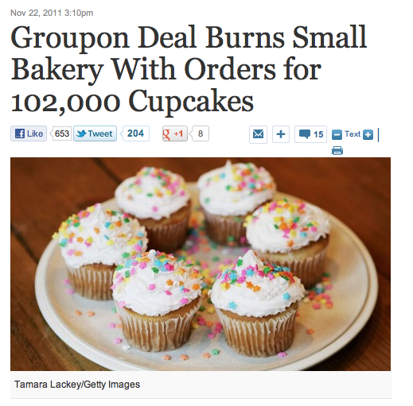
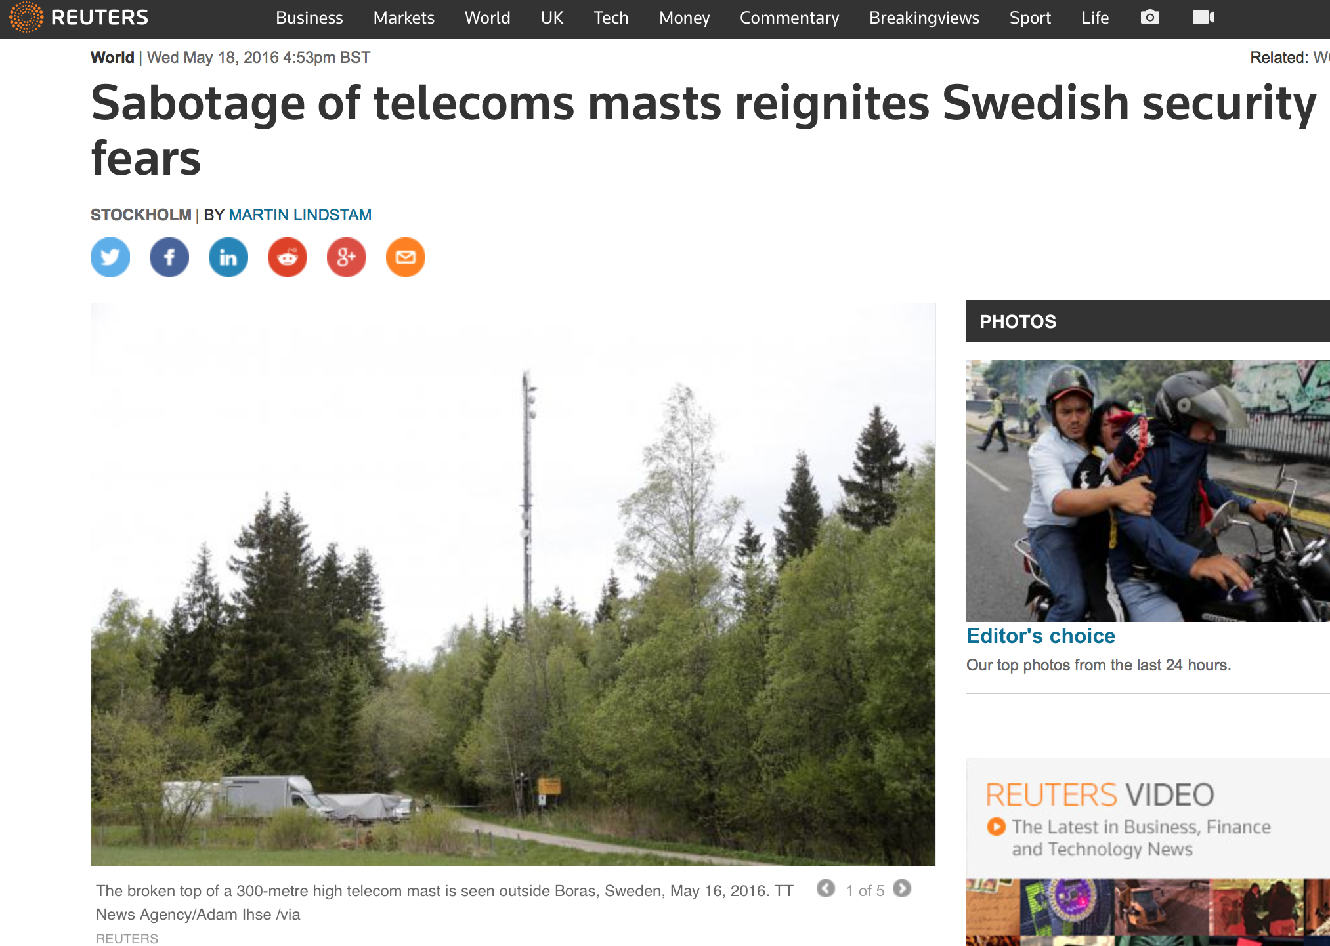
Motivation: context changes, businesses need to adapt
Notes:
Talk about the need to adjust according to context e.g. surge of demand and the available resources, unexpected context changes that prohibit some services.

Slide 4
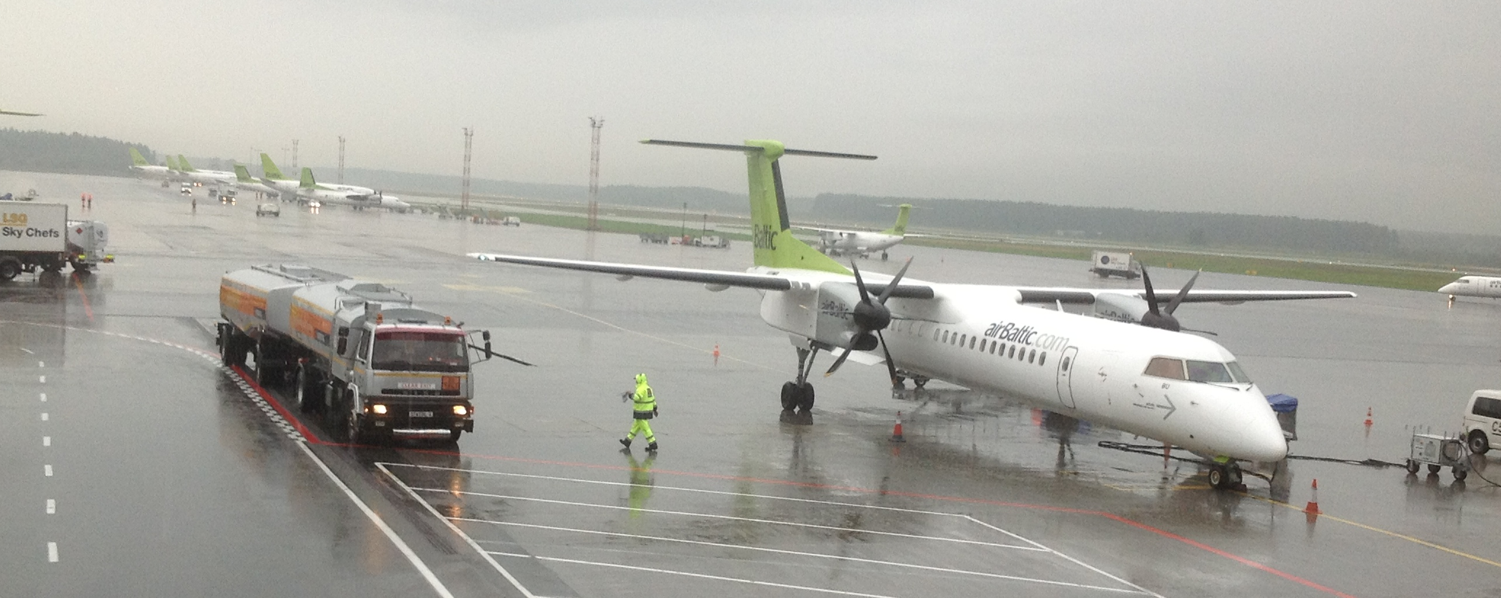
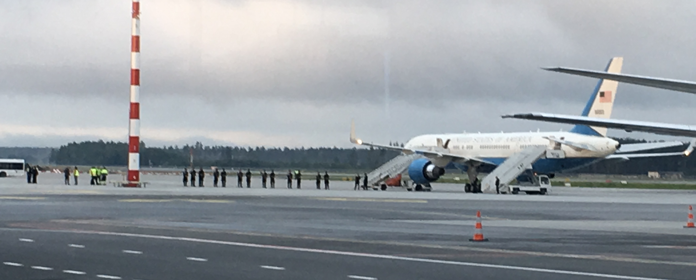

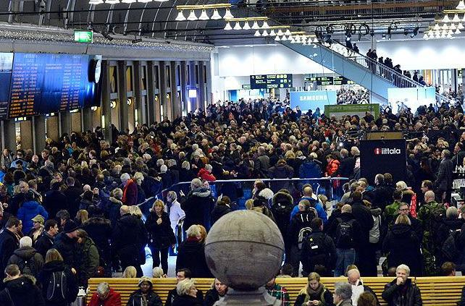
The need for capability as a concept
The goal to accomplish, e.g. efficient operations, no delays, no queues for takeoff, landing, luggage on time
The ability to run the airport, e.g skills, experience
The context in which the airport services must not shut down (weather, passenger intensity, other events, etc.)
The capacity such as money or equipment to refuel aircraft, remove snow, ensure security
Capability: normal day
Capability: normal day + VPOTUS
Capability: snowstorm + runaways closed
Notes:
Explain the key concepts

Slide 5


Design questions to address and the definition of capability
Need to know how to make choices and why (goals and KPIs)
Need to know how to do (ability - processes)
Need to have capacity (resources)
Need to know when to do what (context)
Need to be able to do repetitively (patterns)
Capability is the ability and capacity that enable an enterprise to achieve a business goal in a certain context.

Slide 6
What capability is and is not
In very general terms is can be anything. So, the point here are in terms of CDD which is to a large extent compatible to the EA frameworks
CDD definition: Capability is the ability and capacity that enable an enterprise to achieve a business goal in a certain context.
It is a development construct
It changes over time
It depends on the situation
It can be configured and adjusted
It is critical to the organization
It is defined by a meta-model (see MODAF, NAF, CDD)
It is associated to a development approach and has (some) tool support
It is not anything that the company can do
It is not a service or process
It is not the same as capability in the Capability Maturity Model of SEI
It is not the same as EA capability*
It is not poorly defined and confusing
It is not applicable to all business and IT problems
*EA capability means the capability of a organization tasked to perform EA within some setting

Slide 7
User goals for the CDD methodology
G-1. To increase value of business services
G-3. To provide efficient development methodology
G-8. To have a capability management lifecycle
supports
supports
supports
supports
G-10. To design capabilities
G-9. To capability delivery adjustment
supports
supports
supports
supports
supports
supports
supports
G-27. To identify capability metrics
G-26. To customize services according to context
G-25. To reuse existing components and best practices
G-10. To design capabilities
G-21. To monitor context
G-20. To monitor process execution
G-19. To meet performance and SLA requirements
Notes:
This is from D1.4 requirements analysis. Extensive work with 3 use case companies, survey, etc.

Slide 8
Key aspects of capability

Slide 9
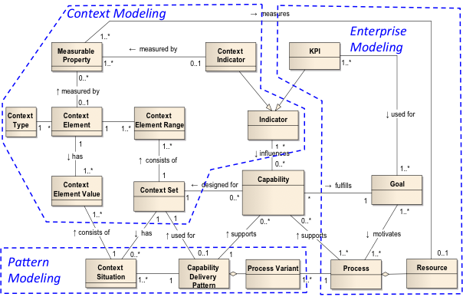
CDD meta-model overview
Notes:
It provides the theoretical and methodological foundation for the CDD [5, 6]. The meta-model has three main sections: a) Enterprise modeling representing the organizational designs with the Goals, KPIs, Processes (with concretizations as Process Variants) and Resources.
Context modeling represented with Situational Context instantiating a set of elements under which the solutions should be applied including Context Indicators for measuring the context properties (Measuring Property); and c) Patterns for delivering Capability by reusable solutions for reaching business goals under different situational contexts. The context defined for the capability should match the context in which the pattern is applicable. The presented meta-model is a foundation for developing capability-oriented software applications driven by capability development life cycle process (Figure 2).

Slide 10
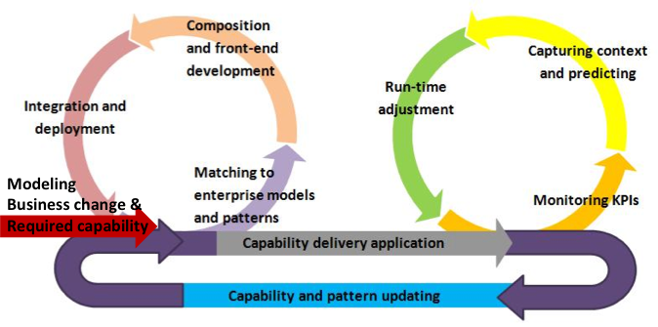
CDD life-cycle process
DESIGN
RUN-TIME
FEEDBACK
Notes:
Show the Dashboard on the next slide?
Veiron...nadji sopstvenu sliku
The scope of this paper – a view on the ”Required Capability”, and from the RE discipline perspective, as a part of the overall CDD methodology guiding the use of...

Slide 11
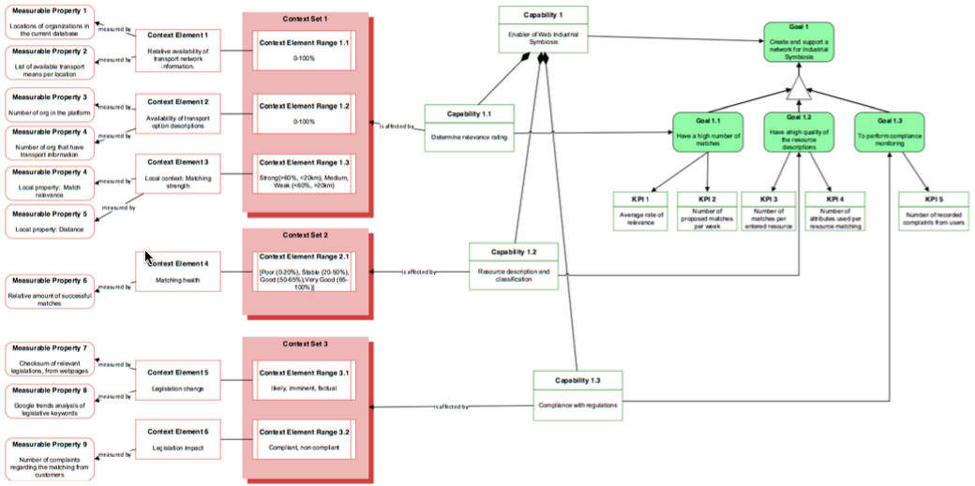
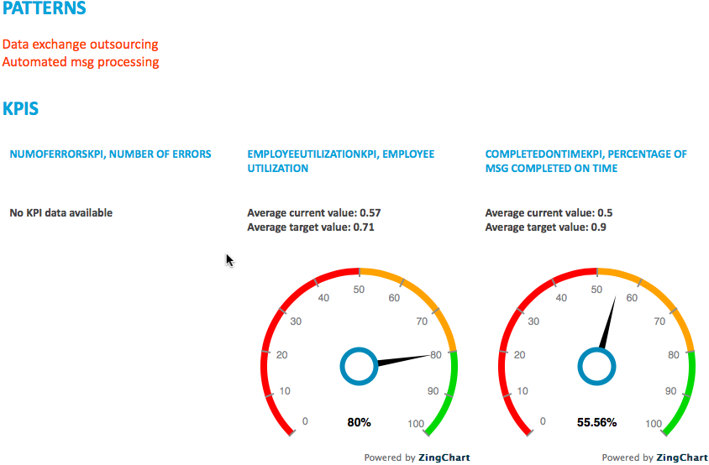
CDD methodology artifacts
DESIGN
RUN-TIME
FEEDBACK

Slide 12
Meta-model Defining the Modeling Language
Model elements for capability design, incl. goals, KPIs, context, measurable properties, patterns, etc.
for variability design
for specifying capability adjustment algorithms,
some components omitted

Slide 13
From Business Process Models to Capability Models - The method & examples
Example of the CDD Steps
Initial definition of scope,
several approaches possible
Alternative method paths ways possible

Slide 14
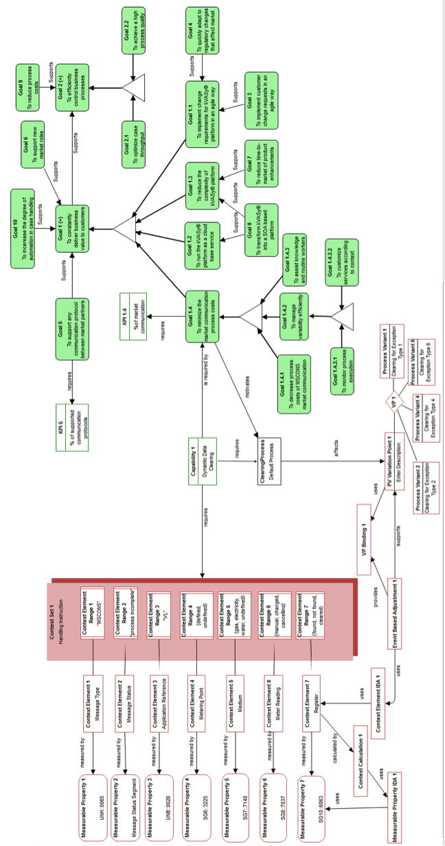
From Business Process Models to Capability Models - The method & examples
Method Component 2: Enterprise Modelling

Slide 15
From Business Process Models to Capability Models - The method & examples
Overview of the method

Slide 16
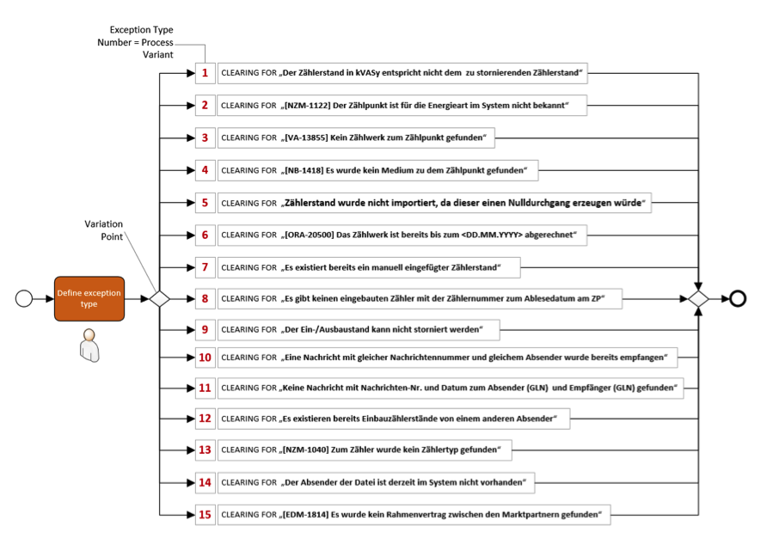
From Business Process Models to Capability Models - The method & examples
Method Component 3: Context Modelling

Slide 17
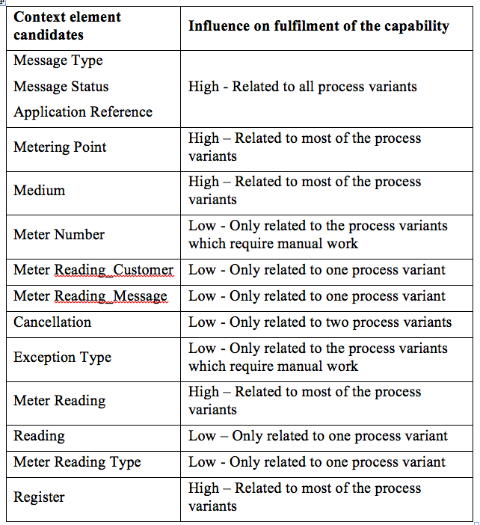
From Business Process Models to Capability Models - The method & examples
Method Component 3: Context Modelling

Slide 18
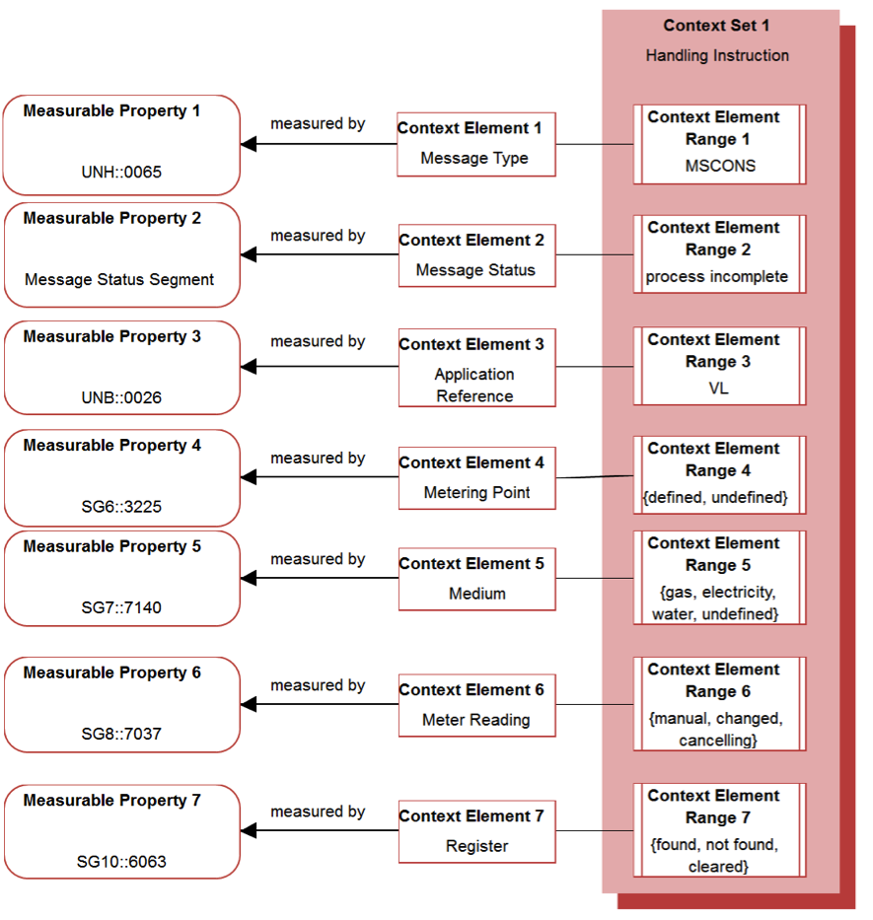
From Business Process Models to Capability Models - The method & examples
Designing Context

Slide 19
From Business Process Models to Capability Models - The method & examples
Capability Model

Slide 20
Alternative scenarios of capability design
Aspect of comparison | Perspective
 | Goal-first | Service-first | Context-first
Primary view on capabilities | Capability fulfils key organisational goals and KPIs | Capability operationalises business services | Capability encompass the management of business contexts
Preconditions with respect to models | Strategy, top-level organisational goals defined. | Pre-existing business process specifications, service-oriented culture. | Pre-defined management structures, product structures or other conceptual models.
Effect/Impact | Provides a base for capability monitoring by the use of KPIs. Reinforces strategic vision and clarifies the IT-business alignment. | Provides a base for having capabilities as the enabler for variety of customer needs. | Provides a base for context-aware variability management.
Notes:
s

Slide 21
Architecture of the CDD Environment
Capability Context Platform
(CCP)
Capability Navigation Application (CNA)
MP value push
Capability model and implementations
Capability Pattern Repository
Adjustment information
MP
Capability Design Tool
(CDT)
Capability Delivery Application (CDA)
Measurable Property (MP) value push
Measurable property (MP) value push
External data providers
Internal data providers
application data
Notes:
Hrvoje

Slide 22
CDD Environment at SIV

Slide 23
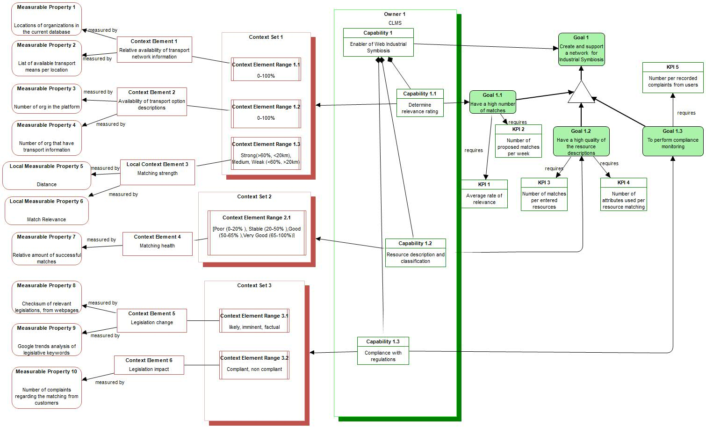
CLMS the case of industrial symbiosis

Slide 24
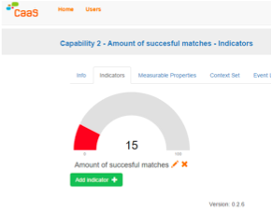
CDD Environment for i-symbiosis

Slide 25
Everis capability design for service promotion
Adjustment algorithm:

Slide 26
Existing use of the concept of capability
Framework | Some capability definitions… there are plenty more
OMG-BA | The ability or capacity that the business possesses or exchanges to achieve certain outcome.
OMG-VDML | The ability of an organization to perform a particular type of work and may involve people with particular skills, intellectual property, defined practices, operating facilities, tools and equipment.
TOGAF | The ability expressed including a combination of organization, people, processes, and technology to achieve it.
DODAF | The ability to achieve a Desired Effect under specified standards and conditions through combinations of means to perform a set of activities.
MODAF | A high level of enterprise’s ability - classification of some ability, specified regardless of whether the enterprise is currently able to achieve it.
NAF | The ability of one or more resources to deliver a specified type of effect or a specified course of action.
O. G. SOA | A category of requirements that fulfills a set of needs. It is aggregated in an Architecture Building Block.
OMG SoaML | A set of functions or resources that a service provided by one or more participants might offer.
… we talked about some of these in the previous lecture.

Slide 27
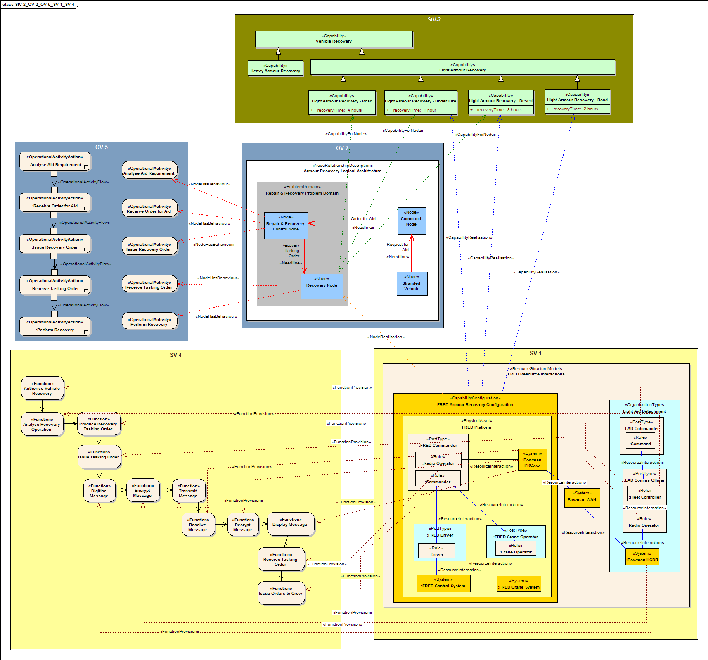
An example of capability design in MODAF

Slide 28
Example of capability taxonomy according to NAF
Source:
https://www.nato.int/cps/en/natohq/topics_157575.htm

Slide 29
Outlook – potential applications
Cyber-resilience – resilient capabilities need to dynamically adjust to adverse cyber-events
Digital transformations of companies – creating new business from traditional and IT capabilities
Big data management – support for enterprise-wide data management, analysis of large business contexts
Continuous and congruent business and IT development.

Slide 30
Additional Reading
http://caas-project.eu lots of papers here
Sandkuhl & Stirna (eds.) Capability Management in Digital Enterprises, Springer (2018) https://link.springer.com/book/10.1007/978-3-319-90424-5
This book descibes the state of the art in capability management we well as presents the CDD approach in detail. Contains presentations of real life cases.
An early paper on capabilities. Not really related to CDD but “ideologically significant”: Teece, Pisano, & Shuen (1997). "Dynamic Capabilities and Strategic Management". Strategic Management Journal. 18 (7): 509–533. http://onlinelibrary.wiley.com/doi/10.1002/(SICI)1097-0266(199708)18:7%3C509::AID-SMJ882%3E3.0.CO;2-Z/epdf

